Slide 1
3D Computer Graphics
The Tech that Powers Video Games
By Maaz Malik

Slide 2


(x3,y3,z3)
Everything, is a bunch of triangles
(x2,y2,z2)
(x1,y1,z1)

Slide 3
A World Contains...
Virtual Light
Source
View Plane
Triangles
Virtual Camera

Slide 4
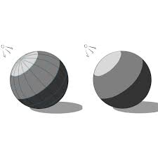
N = A X B
B
X
A
Where is it facing?

Slide 5
Where is it facing?
Cos θ = N · L
|N||L|
L
N
T
NL
θ
[nx ny nz]
lx
ly
lz

Slide 6
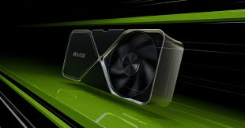
Just One Task...
nx ny nz
lx
ly
lz
lx
ly
lz
lx
ly
lz
nx ny nz
...
...
nx ny nz
Matrix Multiplication

Slide 7



More Interactions, More Computation...
D
f(A)
A
f(D)
f(B)
f(C)
C
What Color is A?
B

Slide 8
More Interactions, More Computation...
D
A
RGB
RGB
RGB
RGB
C
B

Slide 9
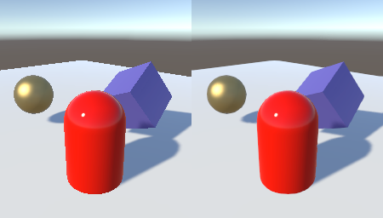
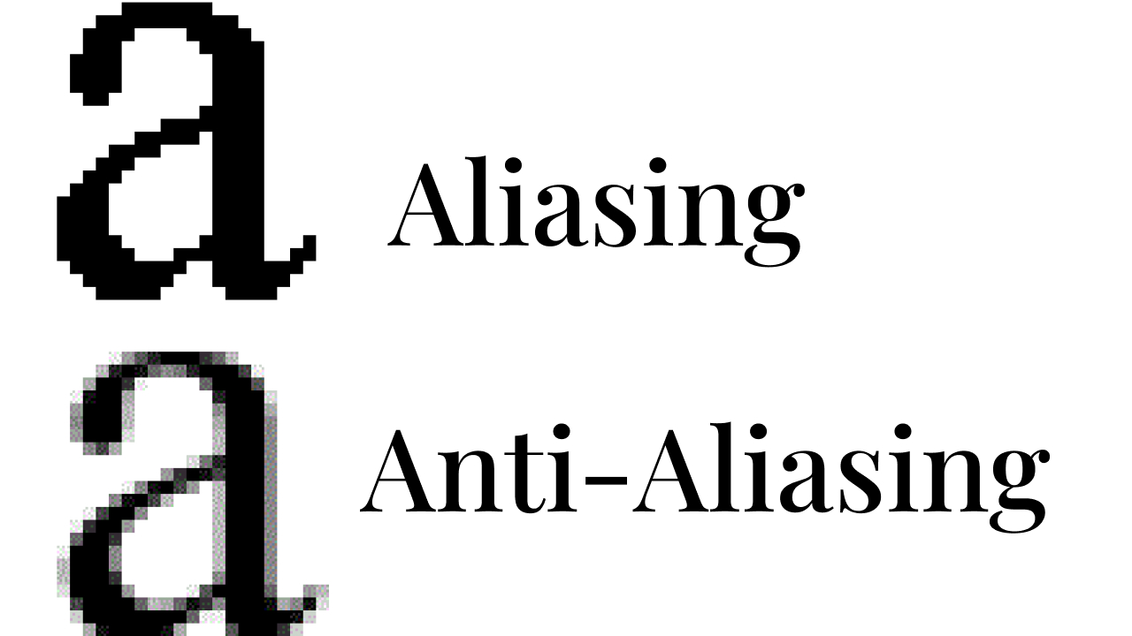
Anti Aliasing

Slide 10
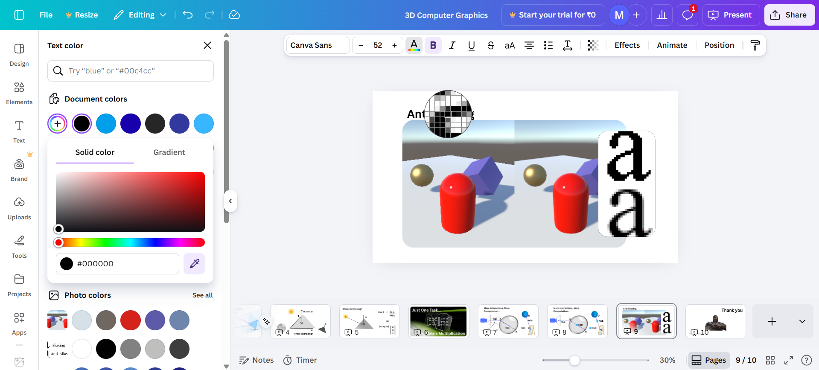

Slide 11
Thank you
By Maaz Malik

